Slide 1

Flood Risk Prediction for Property Owners
By: Abdul Aziz Mohammed

Slide 2
Problem Statement
My Approach
Create a model that can calculate the property level expected loss due to flooding.
For any given property, calculate two values:
Probability of flood damage
Loss given flood damage
Demonstration of the model using Baltimore County
What I Built
3 components:
A probability of flood damage model based on the reference solution
A method to map a property to the probability of flood damage
A method to determine the expected loss due to flooding as a percentage of property value
Build a predictive model that assesses the risk of a property being affected by flooding based on historical flood related data.

Slide 3
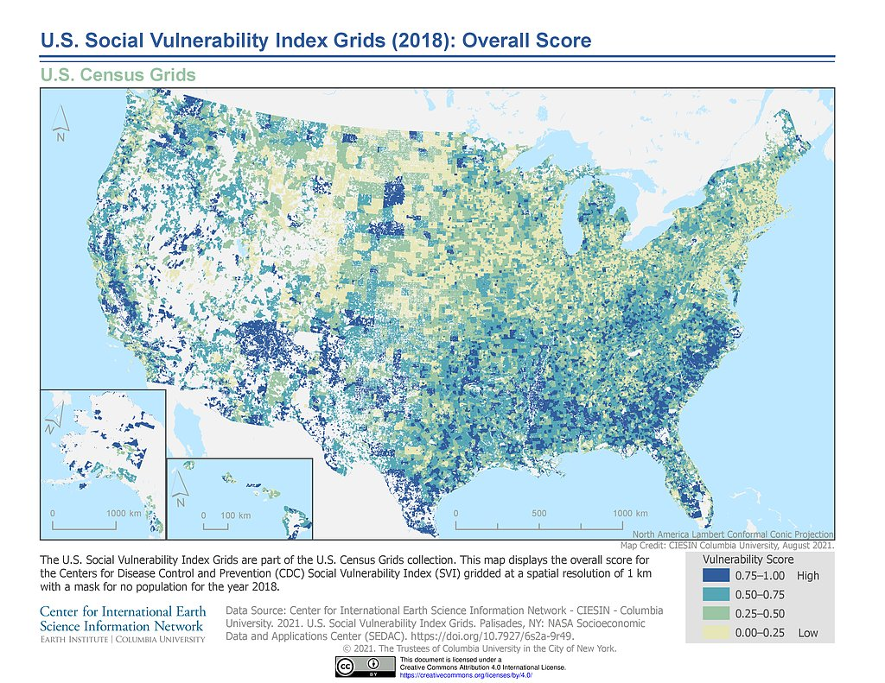
Probability of Flood Enhancement
The reference solution covers variables related to land use and land cover (urban road density, soil) and flood hazard predictors (rainfall, floodplain boundary).
1. Can enhance the model with a layer called ‘social vulnerability,’ which includes socio-economic, household composition & disability, minority status and language, housing type & transportation
Proxy for infrastructure: how equipped for a flood would a high-income area be compared to a low-income area?
Proxy for de-escalation: how many resources would a high-income area receive during a flood compared to a low-income area?
2. Also looked at general climate change variables
Raster file sourced from NASA’s open access data
Raster file sourced from USGS

Slide 4
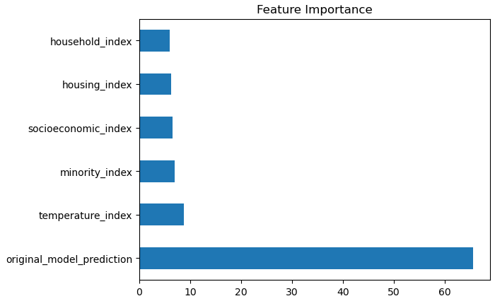
Enhancement Results
Built a CatBoost model on top of the reference solution with the new variables
Competitor had an AUC lift compared to the reference solution
AUC Scores
Reference Solution | CatBoost Competitor
.889 | 0.894

Slide 5
Mapping a Property to Flood Damage Probability
Inputs
Baltimore County Real Property Assessment Data
Baltimore County Shape File
Flood Data Probability for Baltimore County
Use the BC real property assessment data for property value along and transform the latitude/longitude coordinates from EPSG:4326 to FDP data latitude/longitude in EPSG:5070 projection (as in FDP dataset)
Use the BC shape file to clip the FDP raster file to filter it for BC
Use the FPD data to map the flood probability for every property assessment in BC using nearest distance match
Mapped Output
A merged dataset with BC property data along with FPD data
Transformation

Slide 6
Expected Loss from Flooding
Goal:
Estimate a county level measure of severity given flood damage as a percentage of property value
Sources:
Losses – NFIP Claims Data for Maryland: https://nfipservices.floodsmart.gov/reports-flood-insurance-data
Total Payments for 1-4 unit single family residential properties
Property Value – Census Median Property Value: https://www.census.gov/quickfacts/fact/table/baltimorecountymaryland/PST045222
Example Using Baltimore County:
NFIP Total Claims Maryland | NFIP Total Payments Maryland | Average Payment Per Claim | Baltimore County Median Property Value | Expected Loss Given Flood Damage
$ 21,592 | $ 226,903,149 | $ 10,509 | $ 277,500 | 3.79%
Assumptions:
The NFIP payments are representative of a typical loss due to flood damage
The state level losses are representative of losses in Baltimore county
The NFIP data summaries losses by flood zone, we assume damages do not vary flood zone

Slide 7
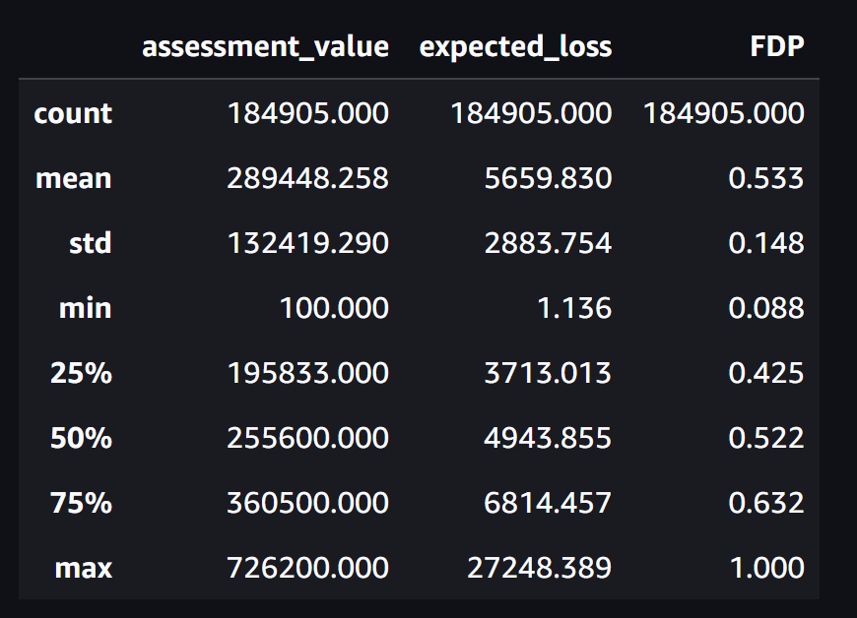
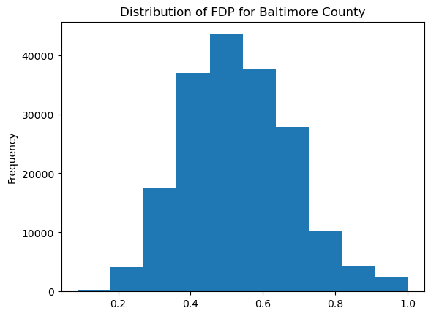
Demonstration Using Baltimore County
Given that we have a 1) Probability of Flood Damage (FDP), 2) Average Severity From Flood (ASF), and 3) Property Value (prop_val)
We can estimate the expected losses as:
Expected loss = prop_val x ASF x FDP
When applied to the Baltimore County dataset:
Number of Properties | Total Assessed Value | Average Property Value | Total Expected Loss | Average Expected Loss | Expected Number of Claims
184905 | $53,520,430,223 | $289,448 | $104,653,0913 | $5659.83 | 98489

Slide 8
My Recipie {Lessons Learnt }
Better organization and planning around the Problem Statement led to deliver 3 components
Github CoPilot and ChatGPT to rescue for ramping up learning with geospatial/raster datasets and transforming code from R to Python
Last but not least, I had fun along the way while learning to put things quickly using AI/ML CatBoost alogrithms, GeoSpatial and Property Data with socio economic data wrangling and modeling and make a compelling business use case.

